Slide 1
Take a Hike
Michael Morales
Jack Harris
Final project, ist 652

Slide 2



In a nutshell, hiking is walking in nature. More specifically, it is walking on unpaved trails in wilderness or natural preserve areas. For some it is a half mile in nature. For others, it is a six month trek spanning 14 states.

Slide 3
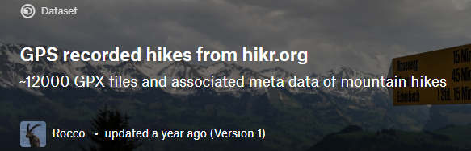
The data:
Our data set came from Kaggle user Rocco, who provided hike information from hikr.org. It contained statistics on hiking trails from
around the world, including length of the hike, change in elevation,
uphill / downhill ratio, duration of the hike, and others. Of particular interest was a difficulty rating, ranging from T1 (Valley hike) to T6
(Difficult High-level Alpine Hike).
The data question:
Could we build a model that would predict the difficulty rating of the hike?

Slide 4
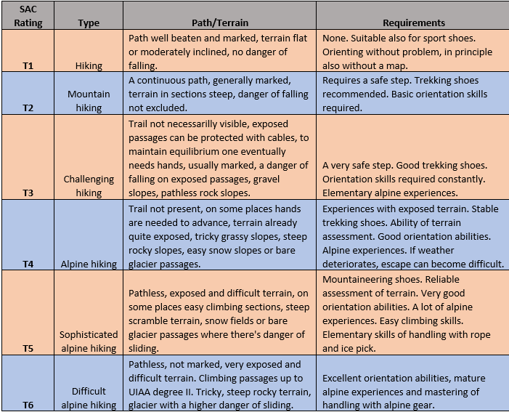

Slide 5

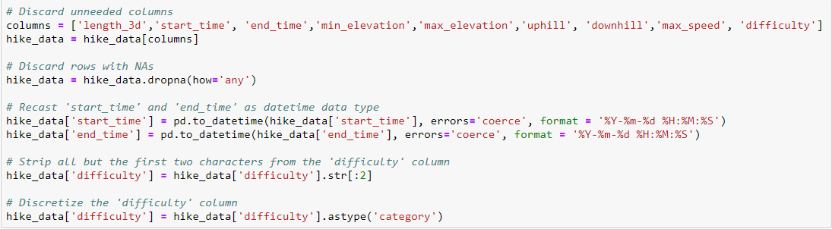
Cleaning and preprocessing the data:
We took the following steps to clean the data:
All irrelevant attributes stripped
Rows with N/A discarded
Attributes involving date or time recast to datetime
Difficulty attribute values shortened to T1, T2, T3, etc.
Difficulty attribute factorized

Slide 6

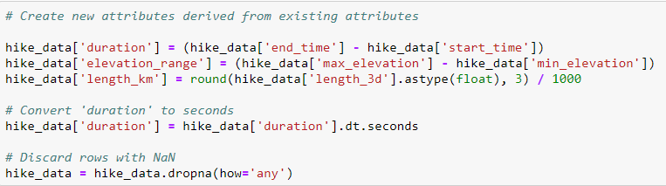
Cleaning and preprocessing the data, continued:
‘Duration’ attribute derived from start and end times
Duration converted to seconds
‘Elevation range’ derived from max and min elevation
N/As generated by cleaning dropped
Duplicate records eliminated

Slide 7
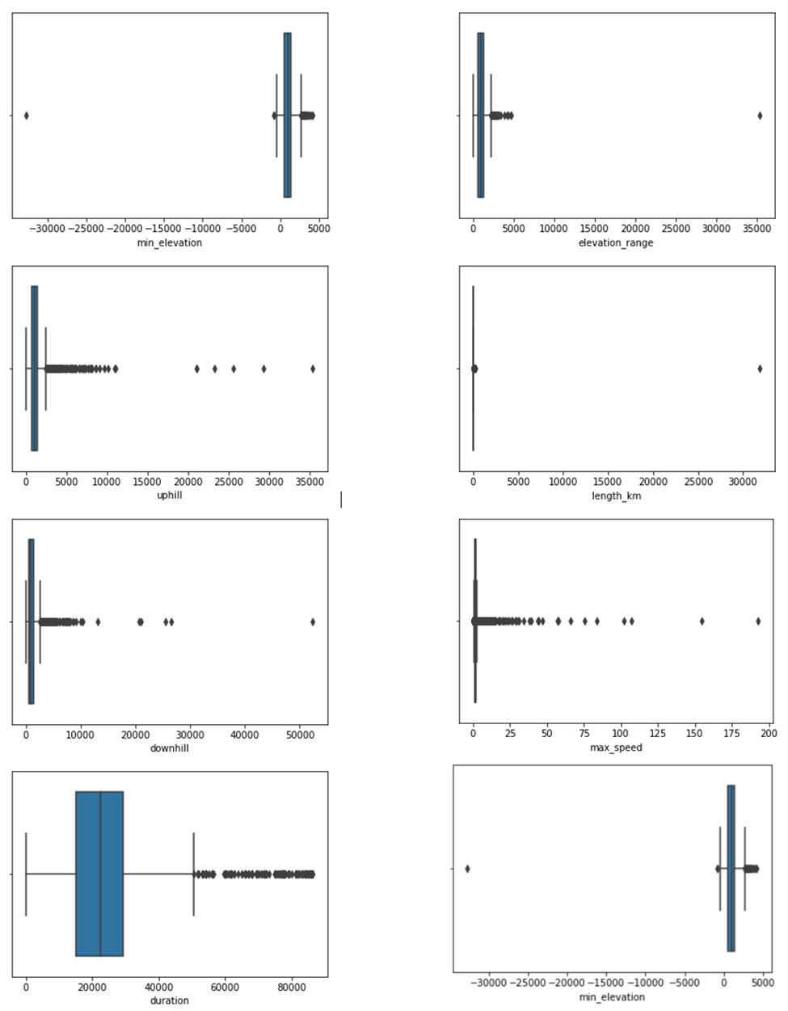

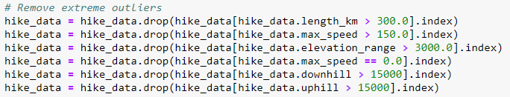
We generated boxplots to
check the shape our data.
Nearly every attribute had
notable outliers (circled in red).
We adjusted the data set to remove these outliers:

Slide 8
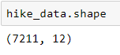
At the conclusion of our data cleaning efforts, we had
7,211 rows and 12 columns of data:
It was time to prepare a final data set to build our predictive models. For our predictors, we pared down the list of attributes to max_speed, length_km, duration, elevation_range, uphill, and downhill. The target variable was the attribute difficulty.

Slide 9
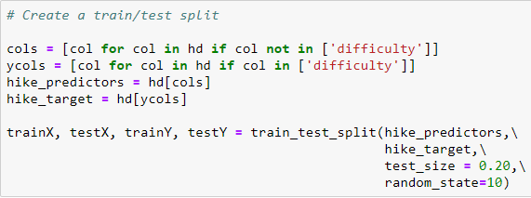
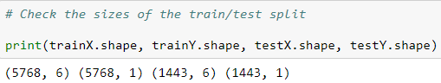
We split our data set into training and testing models, using an 80/20 split:

Slide 10
There is a wide variety of machine learning algorithms to use in building a predictive model. We chose four:
Naïve Bayes
K-Nearest Neighbors
Multinomial Logistic Regression
Random Forest
For each classifier, we ran it in its native form, and then tried it with 5-fold cross-validation.

Slide 11
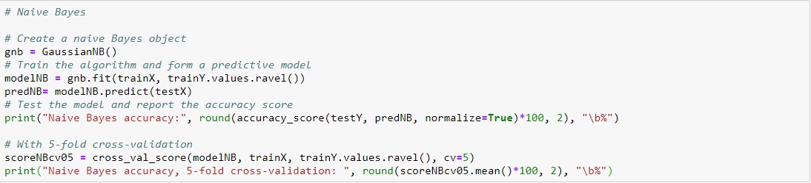
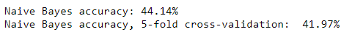
Naïve Bayes
This machine learning algorithm assumes that the predictive variables are independent, or “naïve” of each other.
The results:

Slide 12
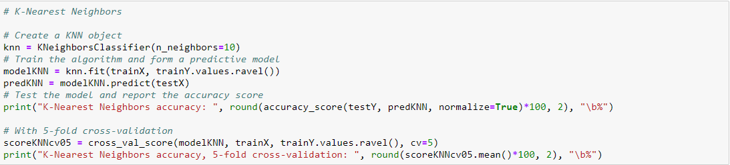
K-Nearest Neighbors
This algorithm attempts to classify each data point by measuring its linear distance to k number of nearest neighbors.
The results:

Slide 13
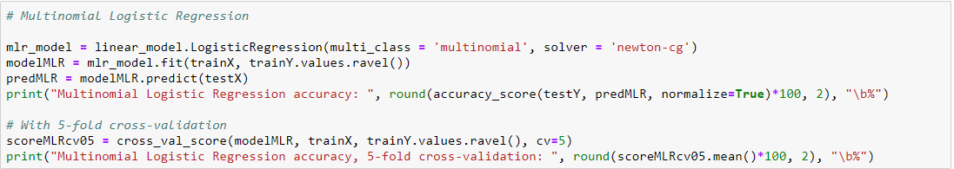
Multinomial Logistic Regression
This method generalizes logistic regression to multiclass (more than two) discrete possible outcomes.
The results:

Slide 14
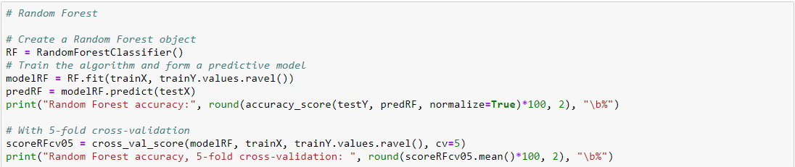
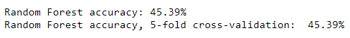
Random Forest
This ensemble method constructs a multitude of decision trees at training time and predicts the mode of the classes of the individual trees.
The results:

Slide 15
Conclusion:
Best accuracy score: multinomial logistic regression, 49.69%
SAC Hiking Scale rates hikes by difficulty
Not included: weather, unsure footing, pathless slopes, unmarked trails, etc.
Subjective ratings
Real World Application:
Check for multi-collinearity
Search for more data
Further tune the models

